Slide 1

Statistics Concepts
SD = [Coefficient of variation * mean ]/100
Coefficient of variation is also known as variance factor.
Variance =
S.D. = root over (variance)
Mode = 3 Median - 2 Mean
Mean is the average that is sum of all nos. by total nos.
Mode is the no. with highest frequency(i.e. that appear most no. of times)
Median is the middle most element, if no. of nos (n), is odd then median is (n+1)/2th number and if n is even median is (n/2 + (n+1)/2)/2.
And for finding median no. should be arranged in ascending order.

Slide 2
Statistics
1. The mean of distribution is 24 and S.D. is 6, what is the value of variance factor ?
2. x,x+3,x+5,x+8,x+9, mean of observation is 9. What will be the mean of last three observations.
3. The mean of data given is 39.2, what is missing frequency:-
x 36 40 35 44
f 10 13 12 --

Slide 3
Statistics
1. Find median of 8,2,4,5,6,7.
2. The score of 7 students are 4,6,3,1,4,2,8 find variance?
3. With what value should the highest quantity in data 65,52,14,26,18,35,32,38 be replaced so that mean and median become equal.

Slide 4
Statistics
1. What is mean deviation from the median for the data given :- 34,46,28,48
2. Mean deviation of data 8,9,12,15,16,20,24,30,32,34?
3. The index nos. of five commodities are 121, 123, 125,126,128 and weight assigned to these are respectively 5,11,10,8,6. Then what is weighted avg index no.?

Slide 5
Statistics
1. Calculate mean and median from the following data:-
0-10 5
10-20 7
20-30 15
30-40 25
40-50 20
50-60 15
60-70 8
70-80 5

Slide 6
Statistics
1. Mode of the following series is 36, find missing frequency in it:-
0-10 8
10-20 10
20-30 --
30-40 16
40-50 12
50-60 6
60-70 7

Slide 7
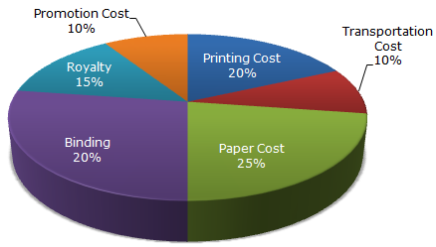
Data Interpretation
1.
If for a certain quantity of books, the publisher has to pay Rs. 30,600 as printing cost, then what will be amount of royalty to be paid for these books?
A. Rs. 19,450
B. Rs. 21,200
C. Rs. 22,950
D. Rs. 26,150

Slide 8
Data Interpretation
2.
What is the central angle of the sector corresponding to the expenditure incurred on Royalty?
A. 15°
B. 24°
C. 54°
D. 48°

Slide 9
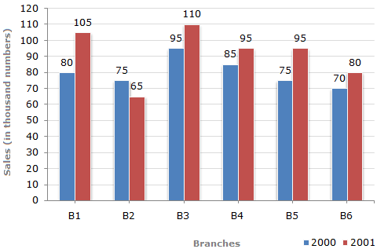
Data Interpretation
The bar graph given below shows the sales of books (in thousand number) from six branches of a publishing company during two consecutive years 2000 and 2001.
Sales of Books (in thousand numbers) from Six Branches - B1, B2, B3, B4, B5 and B6 of a publishing Company in 2000 and 2001.
1.
What is the ratio of the total sales of branch B2 for both years to the total sales of branch B4 for both years?
A. 2:3
B. 3:5
C. 4:5
D. 7:9

Slide 10
Data Interpretation
The bar graph given below shows the sales of books (in thousand number) from six branches of a publishing company during two consecutive years 2000 and 2001.
Sales of Books (in thousand numbers) from Six Branches - B1, B2, B3, B4, B5 and B6 of a publishing Company in 2000 and 2001.
Total sales of branch B6 for both the years is what percent of the total sales of branches B3 for both the years?
A. 68.54%
B. 71.11%
C. 73.17%
D. 75.55%

Slide 11
Data Interpretation
The bar graph given below shows the sales of books (in thousand number) from six branches of a publishing company during two consecutive years 2000 and 2001.
Sales of Books (in thousand numbers) from Six Branches - B1, B2, B3, B4, B5 and B6 of a publishing Company in 2000 and 2001.
What percent of the average sales of branches B1, B2 and B3 in 2001 is the average sales of branches B1, B3 and B6 in 2000?
A. 75%
B. 77.5%
C. 82.5%
D. 87.5%

